Slide 1
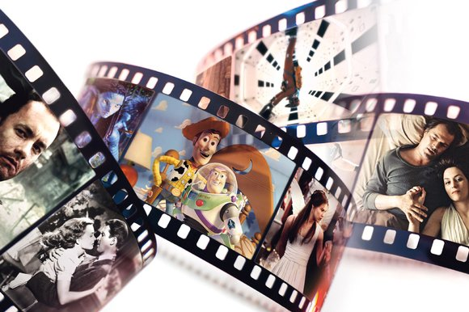
Moving image
a form of entertainment that enacts a story by sound and a sequence of images giving the illusion of continuous movement.

Slide 2
gaming
the playing of games developed to teach something or to help solve a problem, as in a military or business situation.
the playing of computer or video games.

Slide 3
websites
a location connected to the Internet that maintains one or more web pages

Slide 4
audio
sound, especially when recorded, transmitted, or reproduced

Slide 5
publication
the preparation and issuing of a book, journal, or piece of music for public sale.

